Slide 1
Midtown Campus Public Planning Session
The New York Public Library | Building For You
Agenda
Greetings from NYPL President Tony Marx
15-minute presentation on Midtown Campus program planning thus far
Break out into five smaller discussion groups to discuss select program areas
Joining back together in the Salomon Room for a “report back”

Slide 2
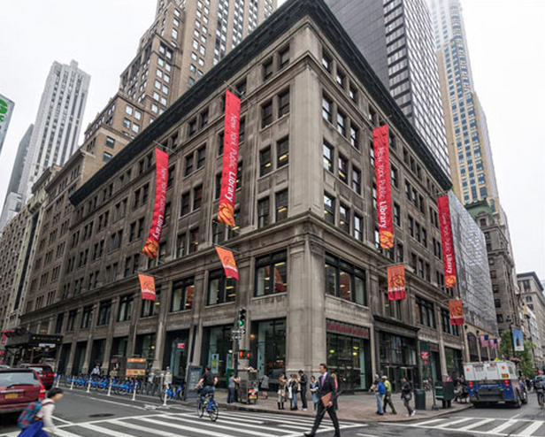
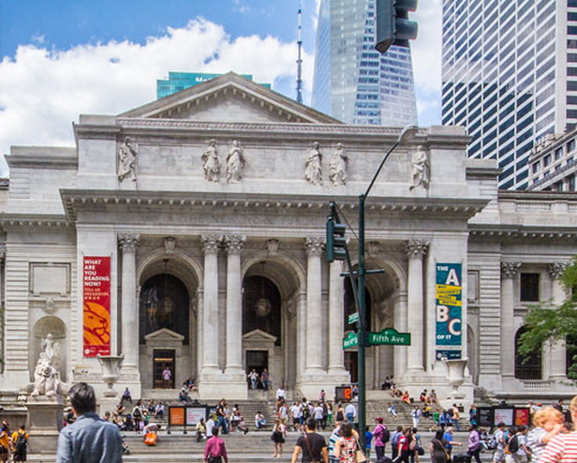
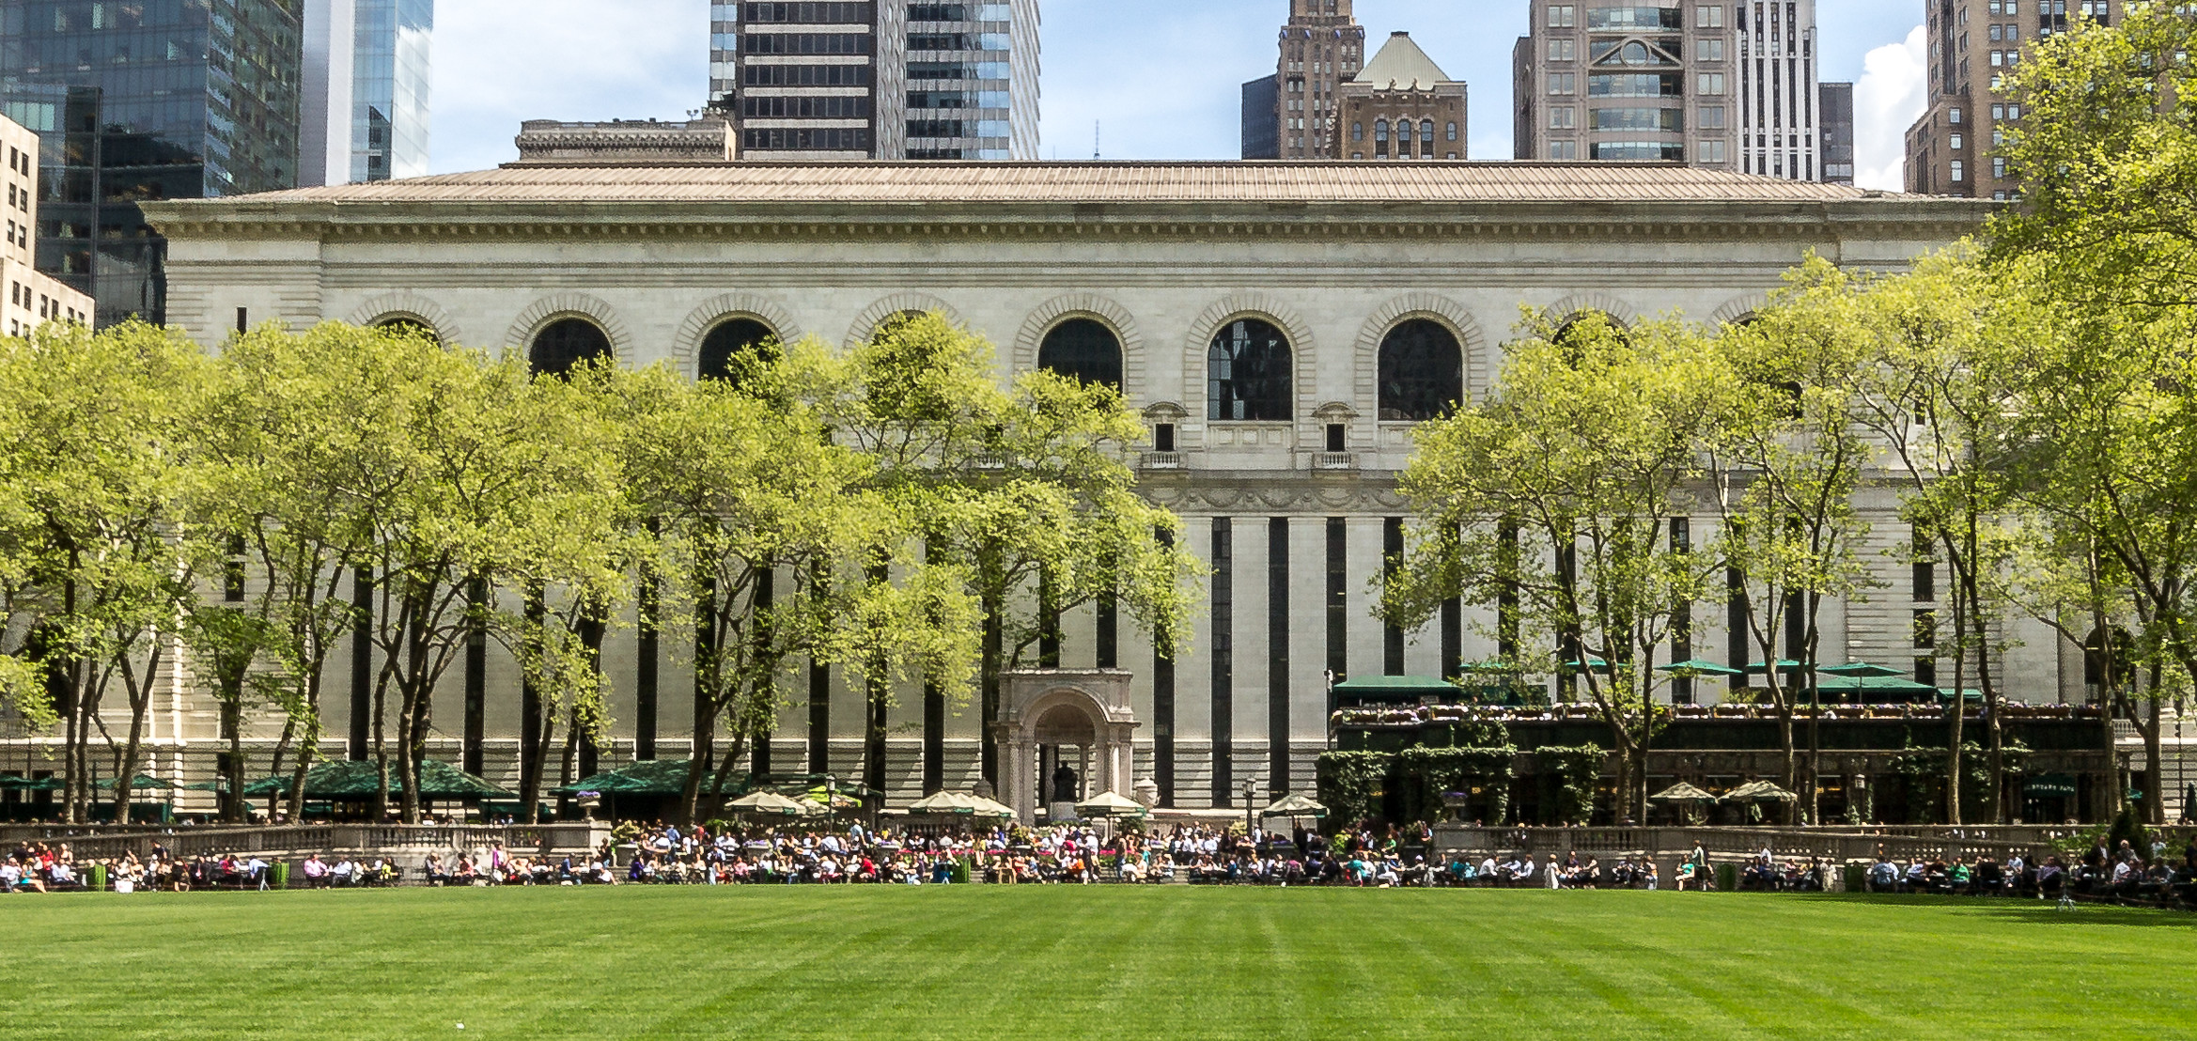
PLANNING FOR MIDTOWN
The Midtown Campus will include the Library’s circulating, research and business functions, offering more public space than currently available in Midtown, along with longer hours and both sustained and enhanced access to collections, technology, and NYPL staff.
Mid-Manhattan
Library
Stephen A. Schwarzman Building
Bryant Park Book Storage Facility
Notes:
NYPL provide Bryant Park image

Slide 3
COMMUNITY ENGAGEMENT
We have solicited public input on our Midtown Campus plans in a variety of ways, including:
User surveys: nearly 50,000 responses
Usage trend analysis: books/media, space use, and technology use
NYPL staff visits: 70+ locations throughout NYC
Midtown User Survey: completed by 15,600 people
In-depth conversations with more than 80 external experts, including the Research Advisory Group
Peer review of other public and research libraries
Notes:
NYPL to send #s

Slide 4
WHAT WE’VE HEARD SO FAR
Major themes from the conversations thus far:
A world-class central circulating library with longer hours of access and greater flexibility and variety
Enhanced and sustained access to physical collections and quality research spaces.
Support for class visits and group meeting spaces
Make staff more visible and accessible
Bring different functions together and make things more convenient
Library has unique value that no one entity can fulfill (school, museum, bookstore, coffee shop, or Internet)

Slide 5
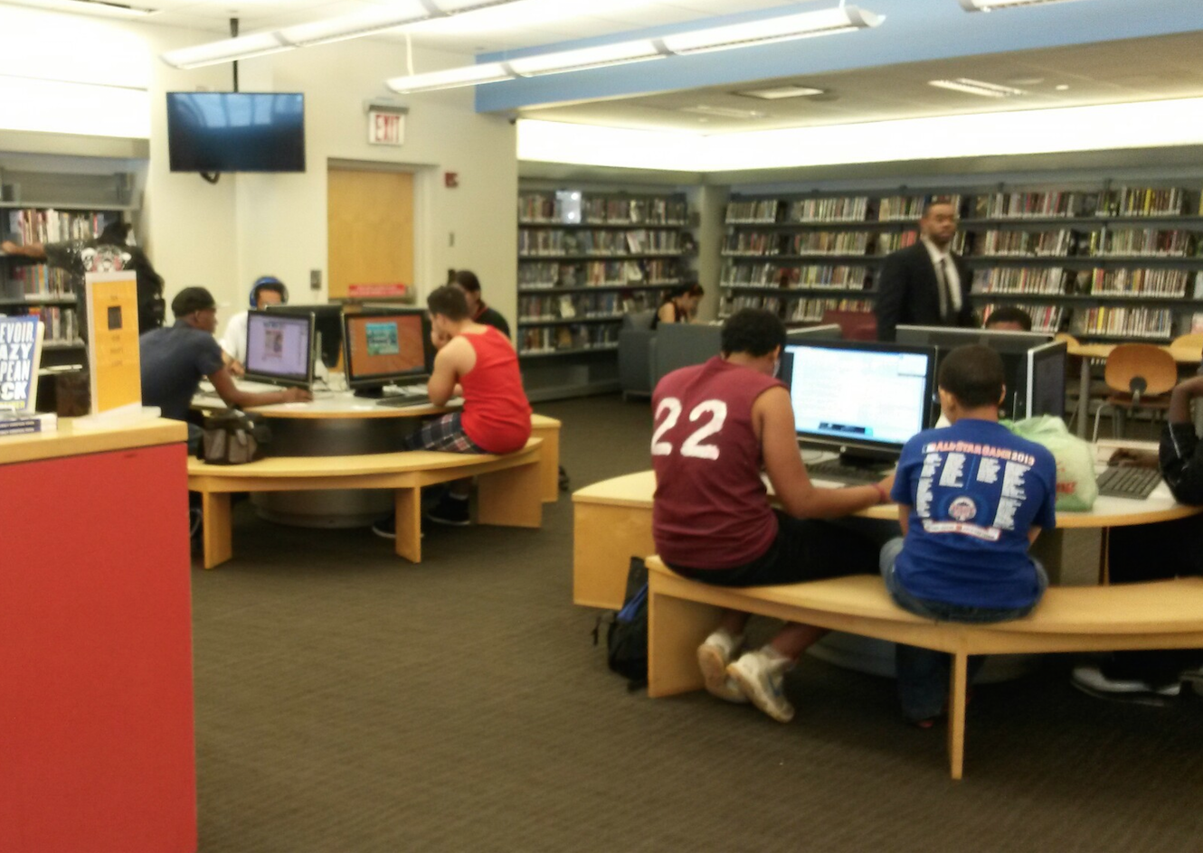
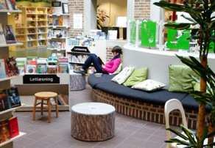
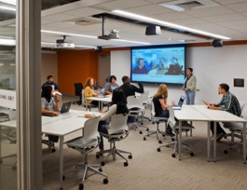
TODAY’S PLANNING / DISCUSSION TOPICS
The key planning and discussion topics for today are:
1 - Research
1 - Research
2 - Core Services
3 - Business Library
4 - PK-12 Education
5 - Adult Education
5 - Adult Education

Slide 6
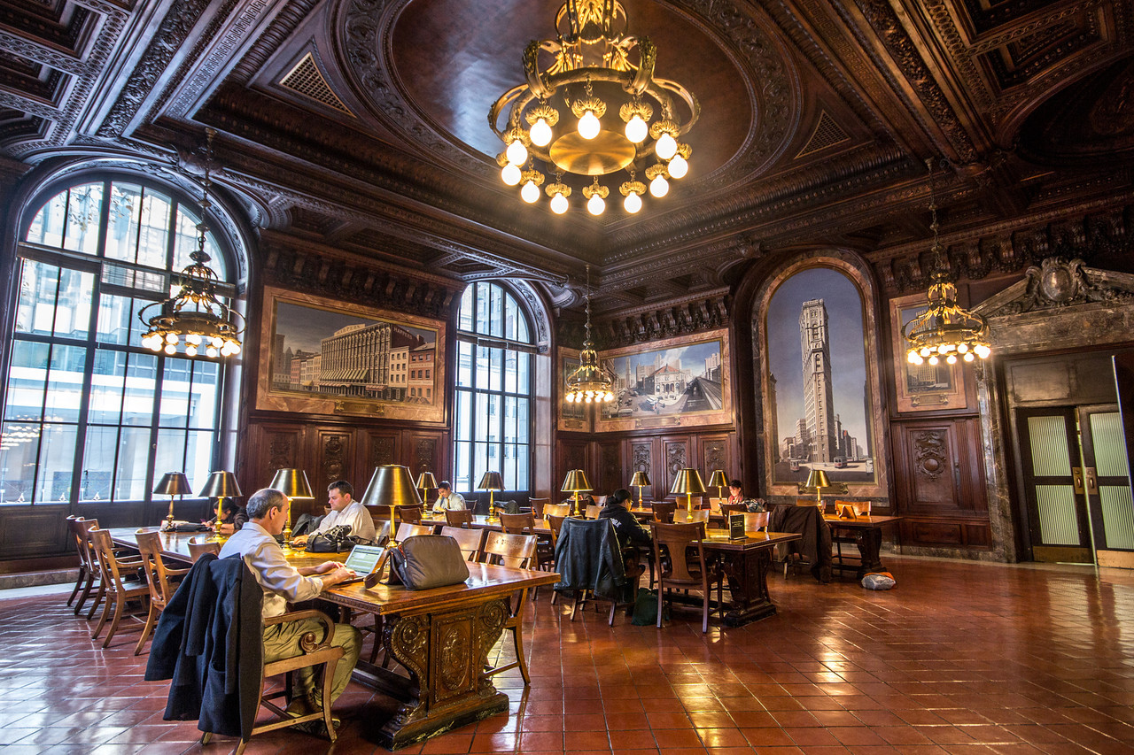
1
RESEARCH AND WRITING CENTER
A hub that will orient researchers, connect them to expert staff, facilitate connections through communal spaces, and support the practical aspects of research.
What we’ve heard:
Ensure timely access to books and collection material for all researchers
Make staff expertise and NYPL orientations more readily available
Maintain traditional quiet spaces
Stephen A. Schwarzman Building

Slide 7
RESEARCH AND WRITING CENTER
Key Questions:
Can you describe an ideal research/work experience at a library?
Would you take advantage of: public orientation classes, individual staff consultations, informal subject or collections-based programs, opportunities to meet others working on similar projects - and for professors, assistance in planning courses based in the collections?
What kinds of practical facilities could the library offer to researchers? Lockers, personal shelving, research lounge, advanced digital technologies (hardware/software), bookable meeting space?

Slide 8
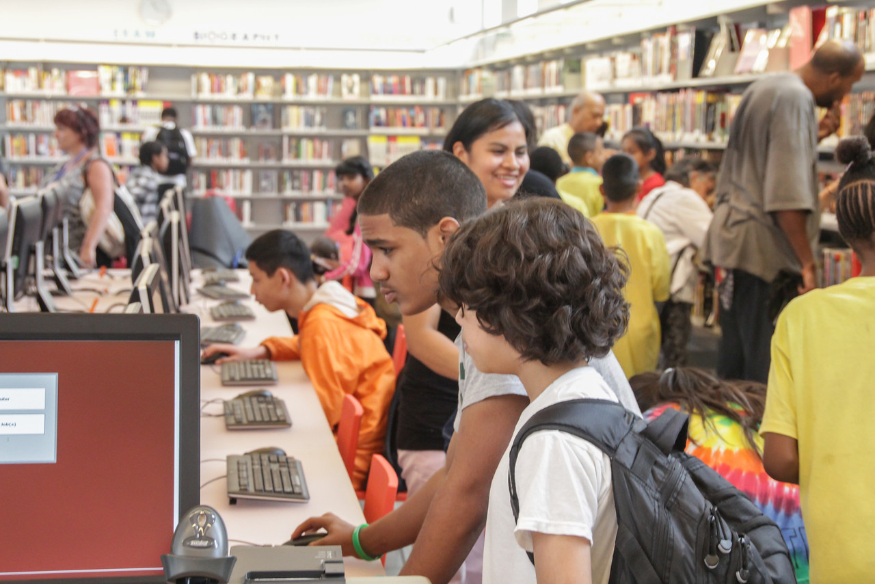
2
CORE SERVICES
Embracing new concepts while maintaining all traditional library circulating services, including books and media, technology access, programs, quiet space, access to staff expertise, and group spaces.
What we’ve heard:
More quiet space, more collaborative space, more hours
More “must-see” programs and exhibitions
Better orientation for visitors looking to utilize library services
Stapleton Library

Slide 9
CORE SERVICES QUESTIONS
Key Questions:
What are the reasons you come to the library? What kinds of services, programs, technology, and spaces do you think are most important for the library to provide?
What is the right proportion of space for quiet individual work vs. more lively group work?
How can NYPL best create environments where books, work spaces, classrooms, and staff are close together?

Slide 10
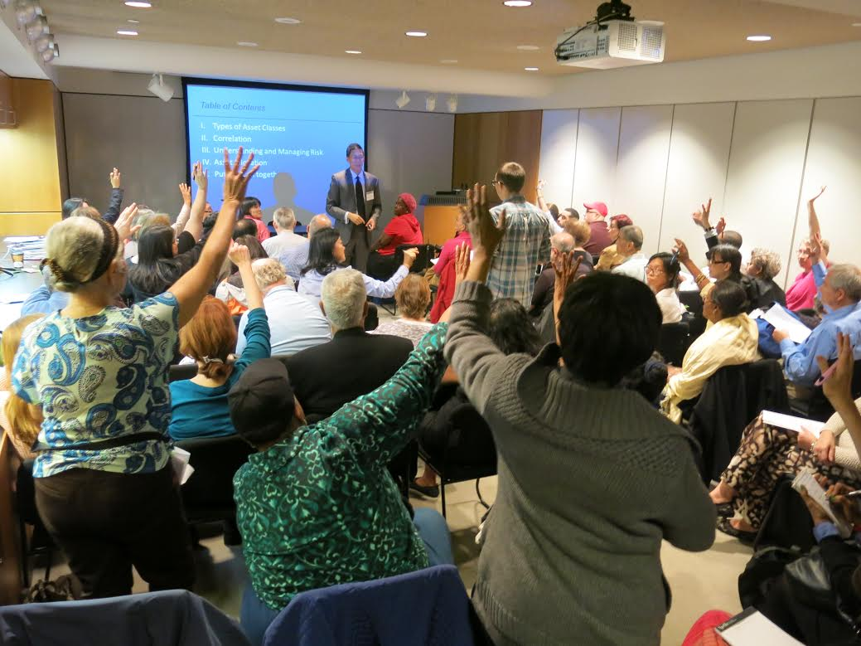
3
BUSINESS LIBRARY
A place for existing and aspiring business owners, entrepreneurs, and innovators to start and grow businesses through resources, advice, programs, and work spaces.
What we’ve heard:
Research assistance and expertise (business planning, marketing)
Physical and electronic collection access and programs, from mentoring to classes to events
Quiet work space, private advisory offices and collaborative meeting / project space
Science, Industry and Business Library

Slide 11
BUSINESS LIBRARY
Key Questions:
What types of projects or business / professional needs are you looking for at the Business Library?​
What ​kinds of training, assistance, and interactions are most valuable to you? What ​kinds of information ​resources are most ​useful (for example, current vs. historical, print vs. digital)?
What is the right balance of private work spaces ​and advisory offices ​and active, collaborative meeting and project spaces?

Slide 12
4
LEARNING CENTER FOR CHILDREN AND TEENS
A destination for youth, their families, and educators with world class collections, state-of-the-art technology and dynamic programming focused on basic literacies.
What we’ve heard:
Spaces for programs and hands-on activities for children / teens and programs for educators and caregivers
Opportunities to see NYPL Treasures exhibitions
Access to collections for reading and technologies for hands-on making
High Bridge Library

Slide 13
LEARNING CENTER FOR CHILDREN AND TEENS
Key Questions:
What children’s and/or teen programs, events, and activities are you most interested in?
What other spaces and activities in the building should the Learning Center draw from/connect to?
What kinds of resources/technologies/interactive elements would most draw children and teens to the Center? What could children and teens create there?

Slide 14
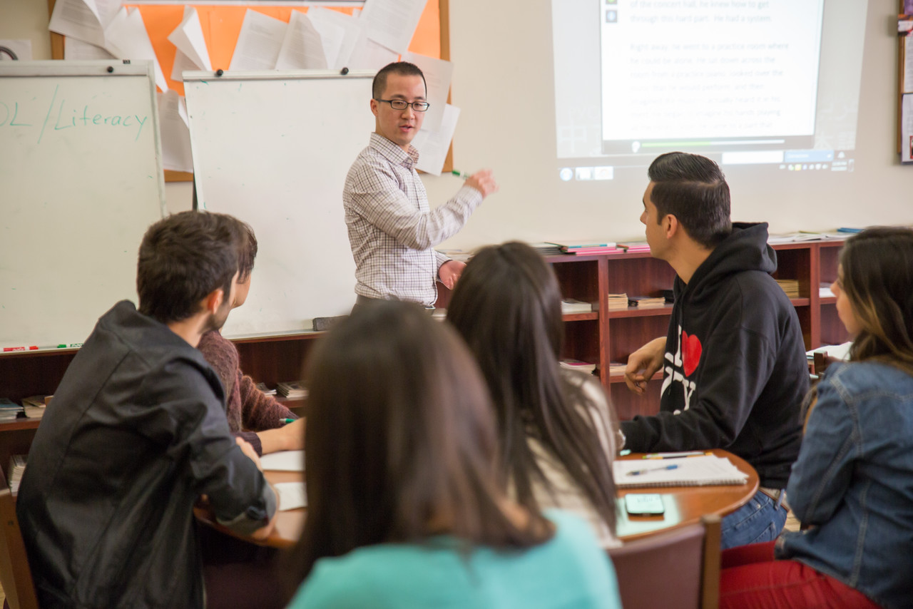
5
LEARNING CENTER FOR ADULTS
A place for adults to learn technology and language skills and receive job /career assistance, with classrooms, work spaces, and staff experts.
What we’ve heard:
Increasing demand for classes and programs, for diverse lifelong learning
Flexible classrooms to accommodate different teaching / learning styles
Need for technology training and English literacy and language instruction
St. Agnes Library

Slide 15
LEARNING CENTER FOR ADULTS
Key Questions:
What classes and programs do you want from an adult education center?
How can the center support adults engaged in lifelong learning with resources, spaces, and staff?
What is the right mix of spaces for classes vs. spaces for individual and group work?

Slide 16
BREAKOUT DISCUSSIONS
We will now break into five discussion groups to discuss these and other questions and then return to report out and wrap up. Breakout groups:
Research and Writers (including digital humanities) | Salomon Room
Core Services (circulating books/media, space, and technology) | Second Floor Corridor
Business Library | North Hallway
PK-12 Education | McGraw Rotunda
Adult Education (ESOL, computer classes, job courses, etc.) | South Hallway

Slide 17
REPORT BACK
What were the key themes from your discussion?
Consider the following overall topics for your report back:
Why would people go there?
Spaces, technology, and furniture needs?
Potential programs and events?
Collections and staff access needs?
Relationships to other spaces and programs?
Other?

